Slide 1
My attempts for fitting
Which are really crude

Slide 2
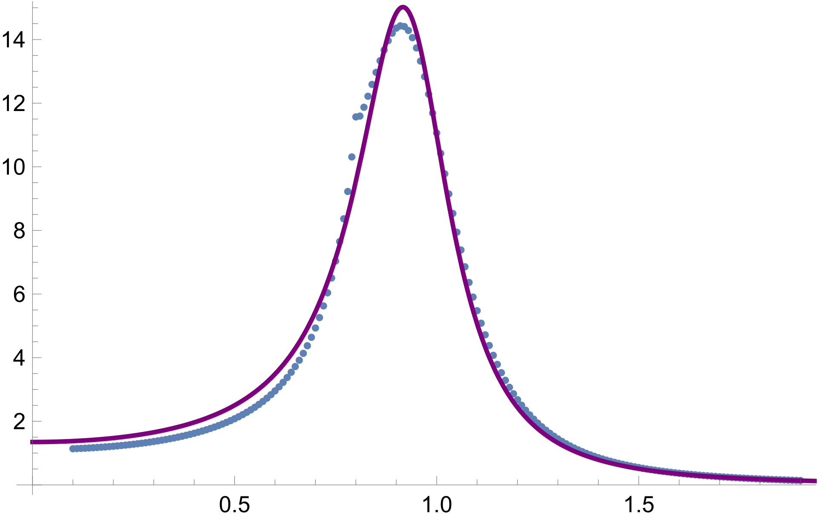
Fitting
m=0.1M~1.9M, sample distance 0.01M
Using NonlinearModelFit in Mathematica
R^2 value as a ‘goodness’ of fit

Slide 3
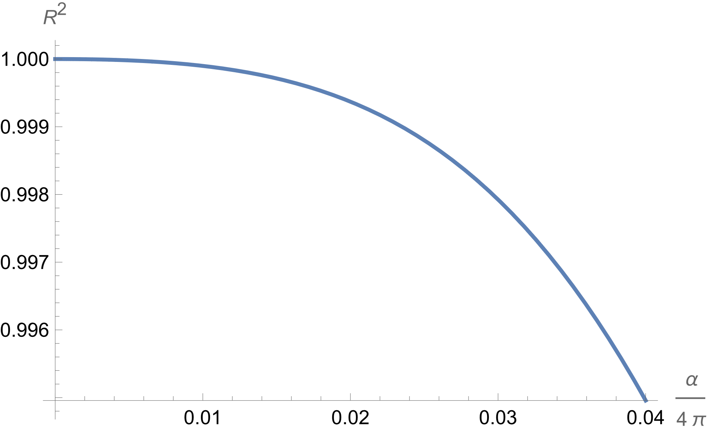
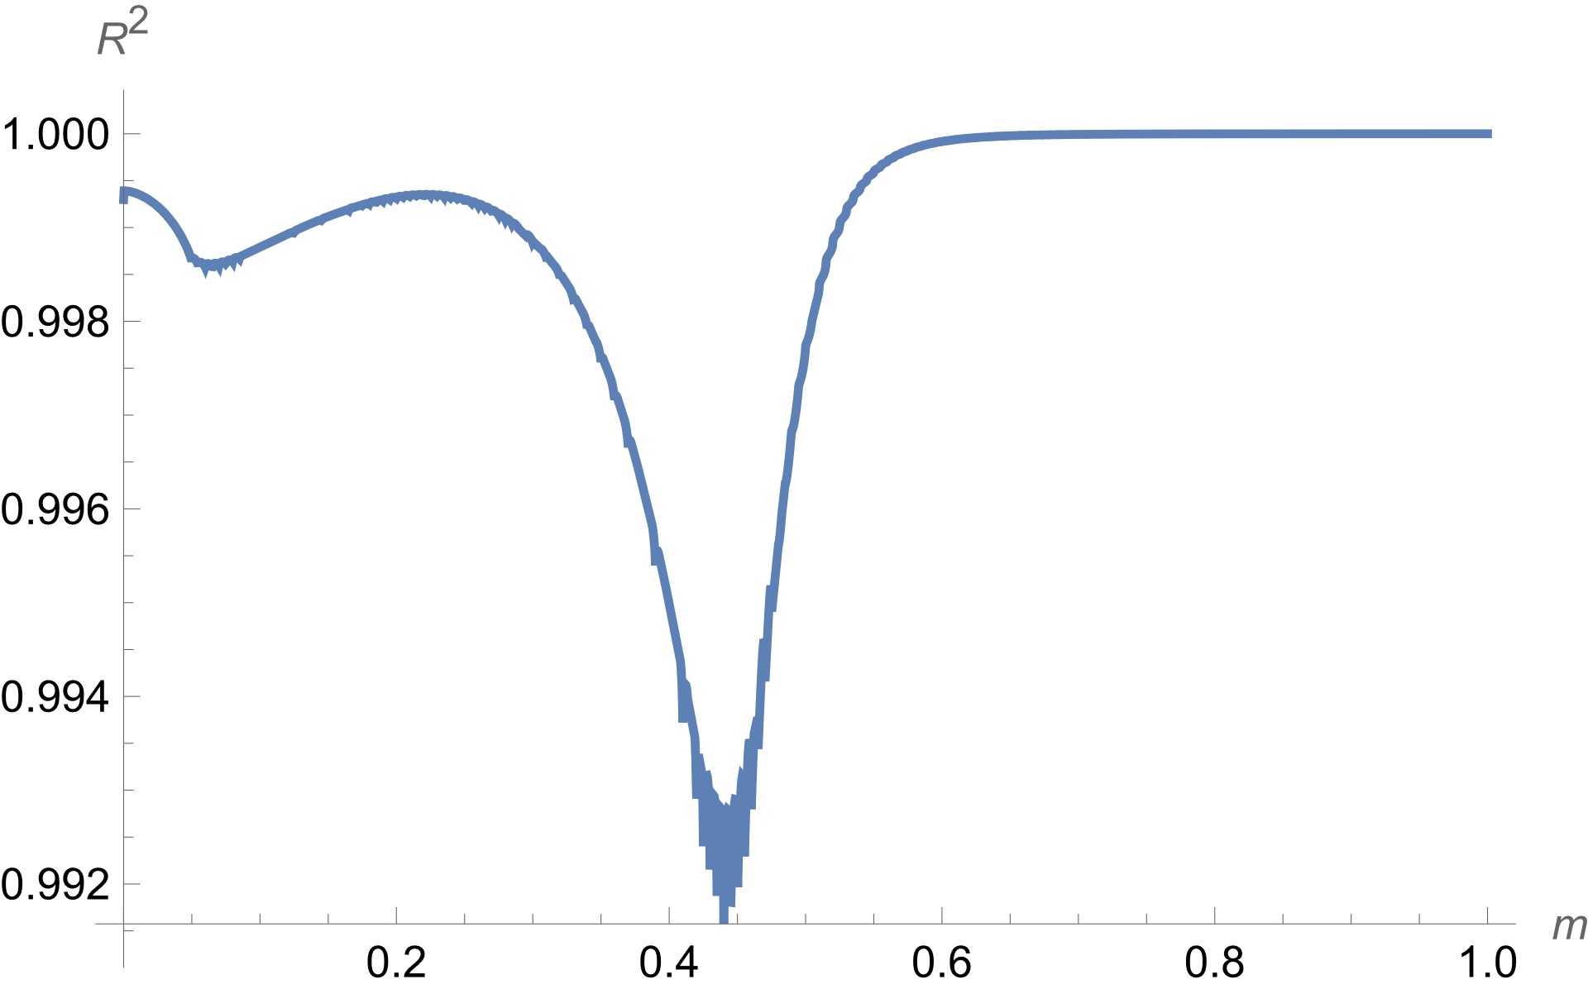
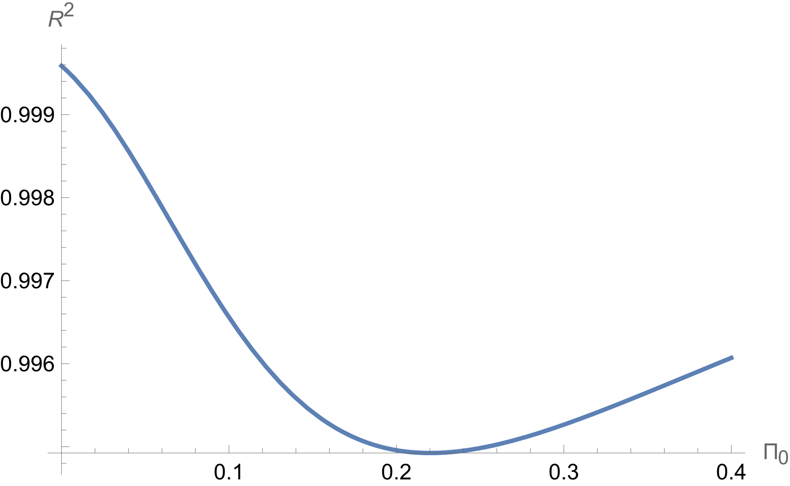
Varying parameters to see how good is the fit
Coupling constant
Particle mass (threshold/2)
Constant decay
Statistically a bit misleading, especially on the third plot

Slide 4
Light particles
reaffirming that the problem is not easy

Slide 5
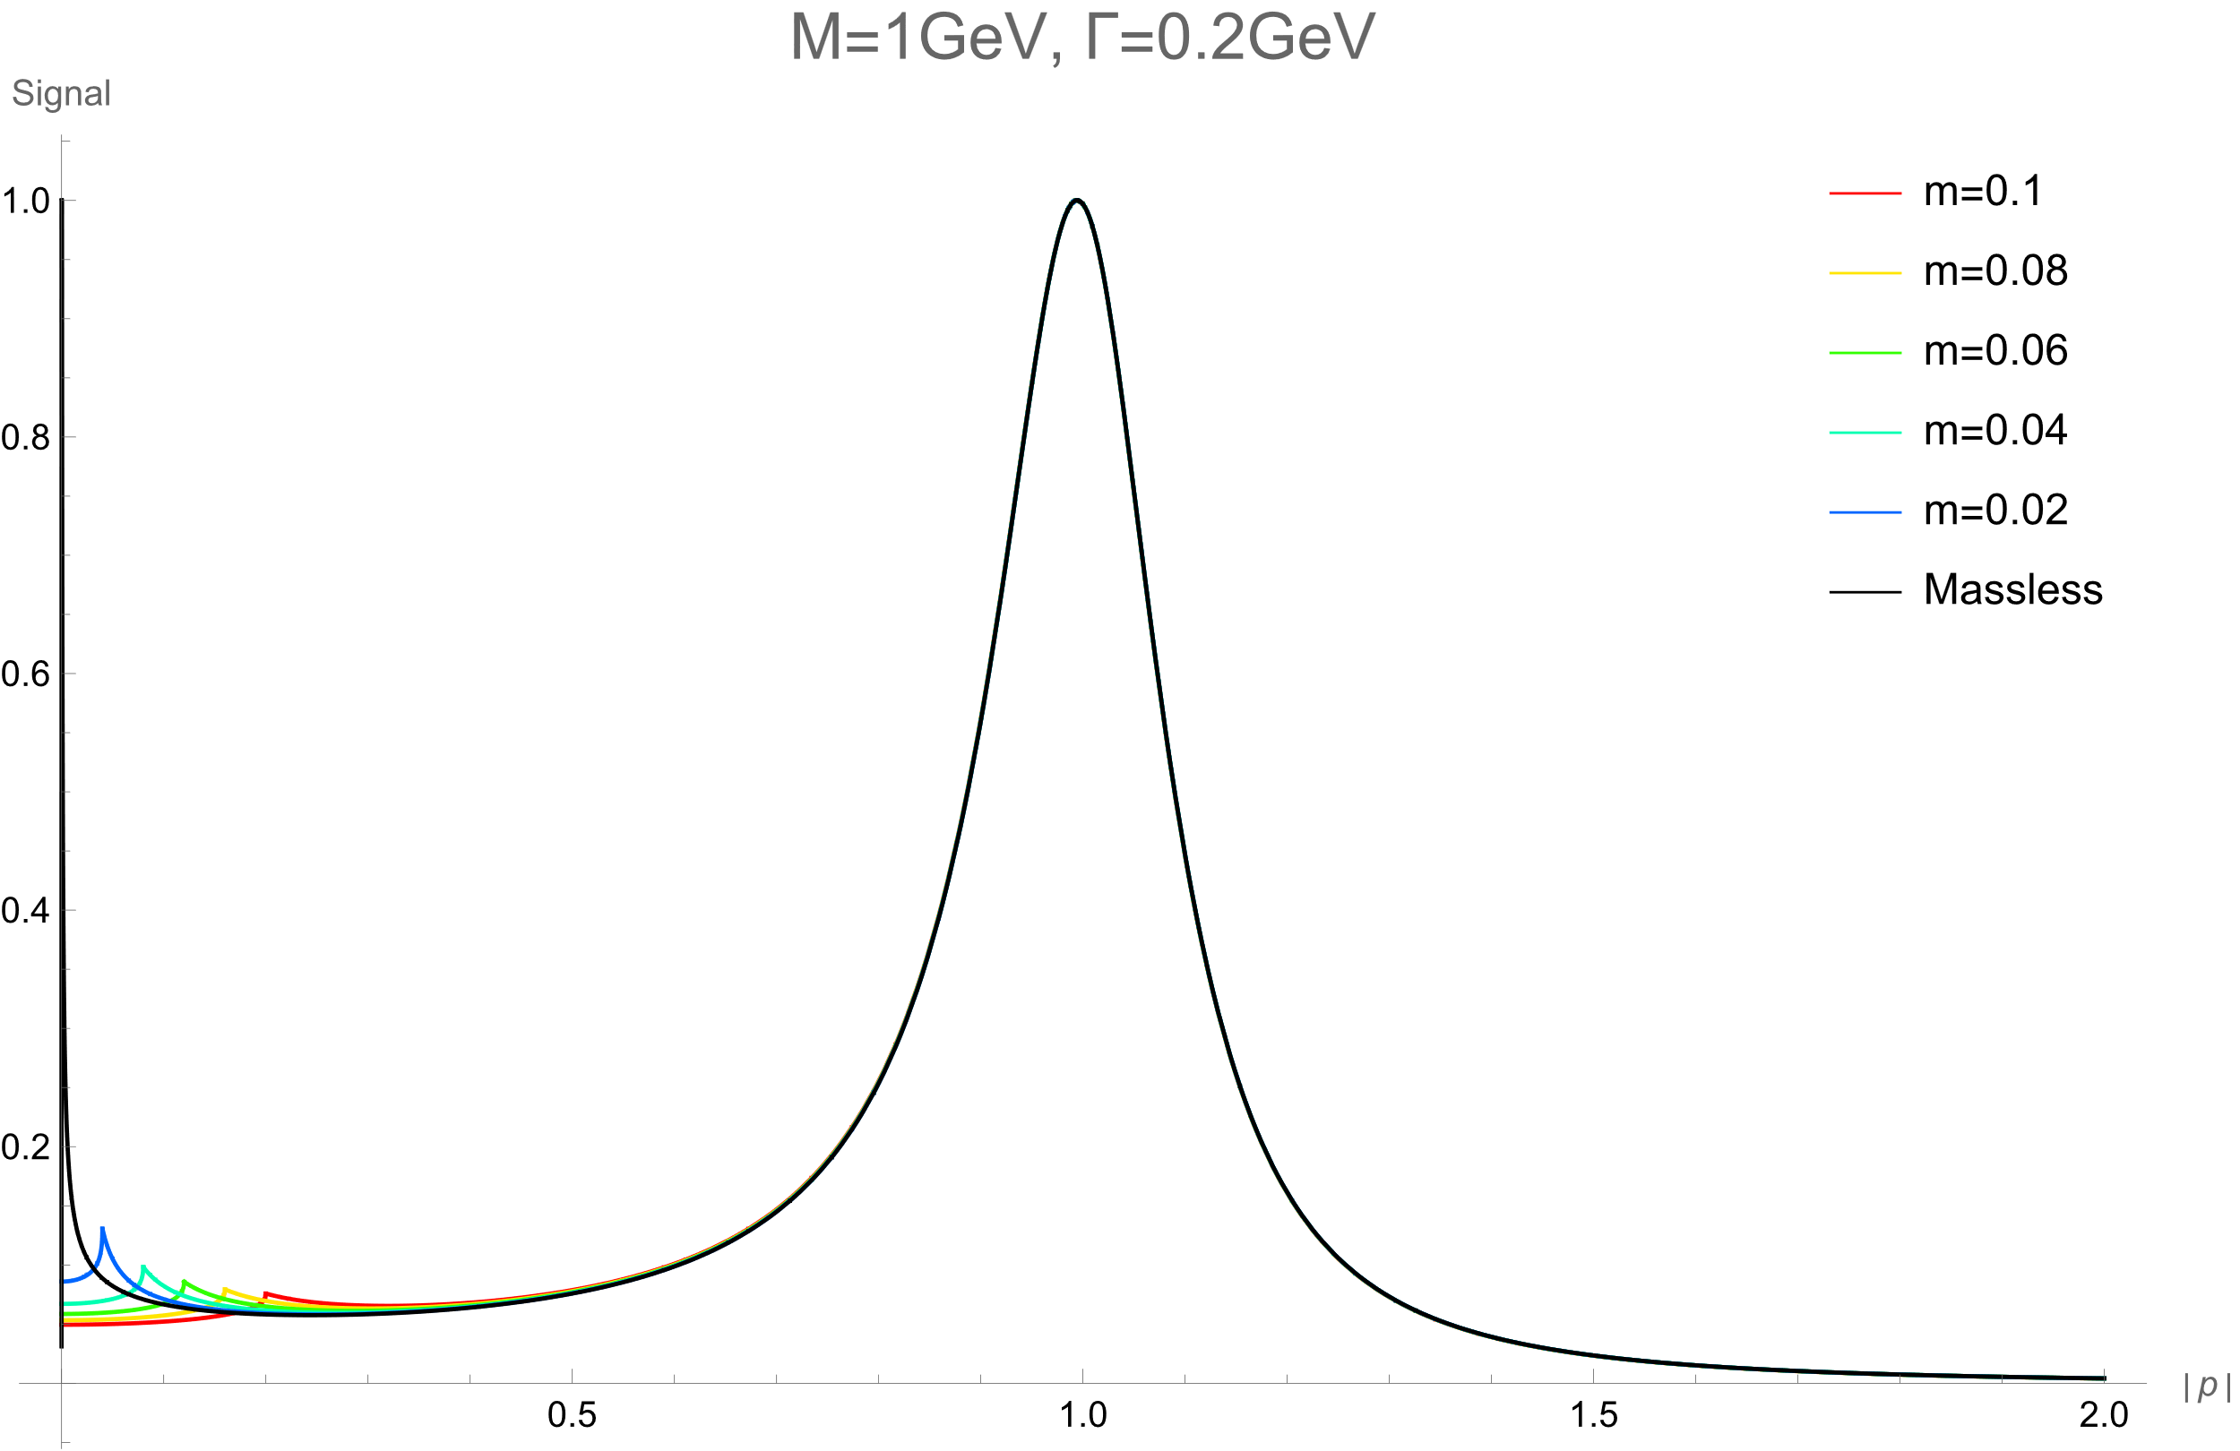
Signal shape, full region
Complex on-shell
OK for nonzero m?

Slide 6
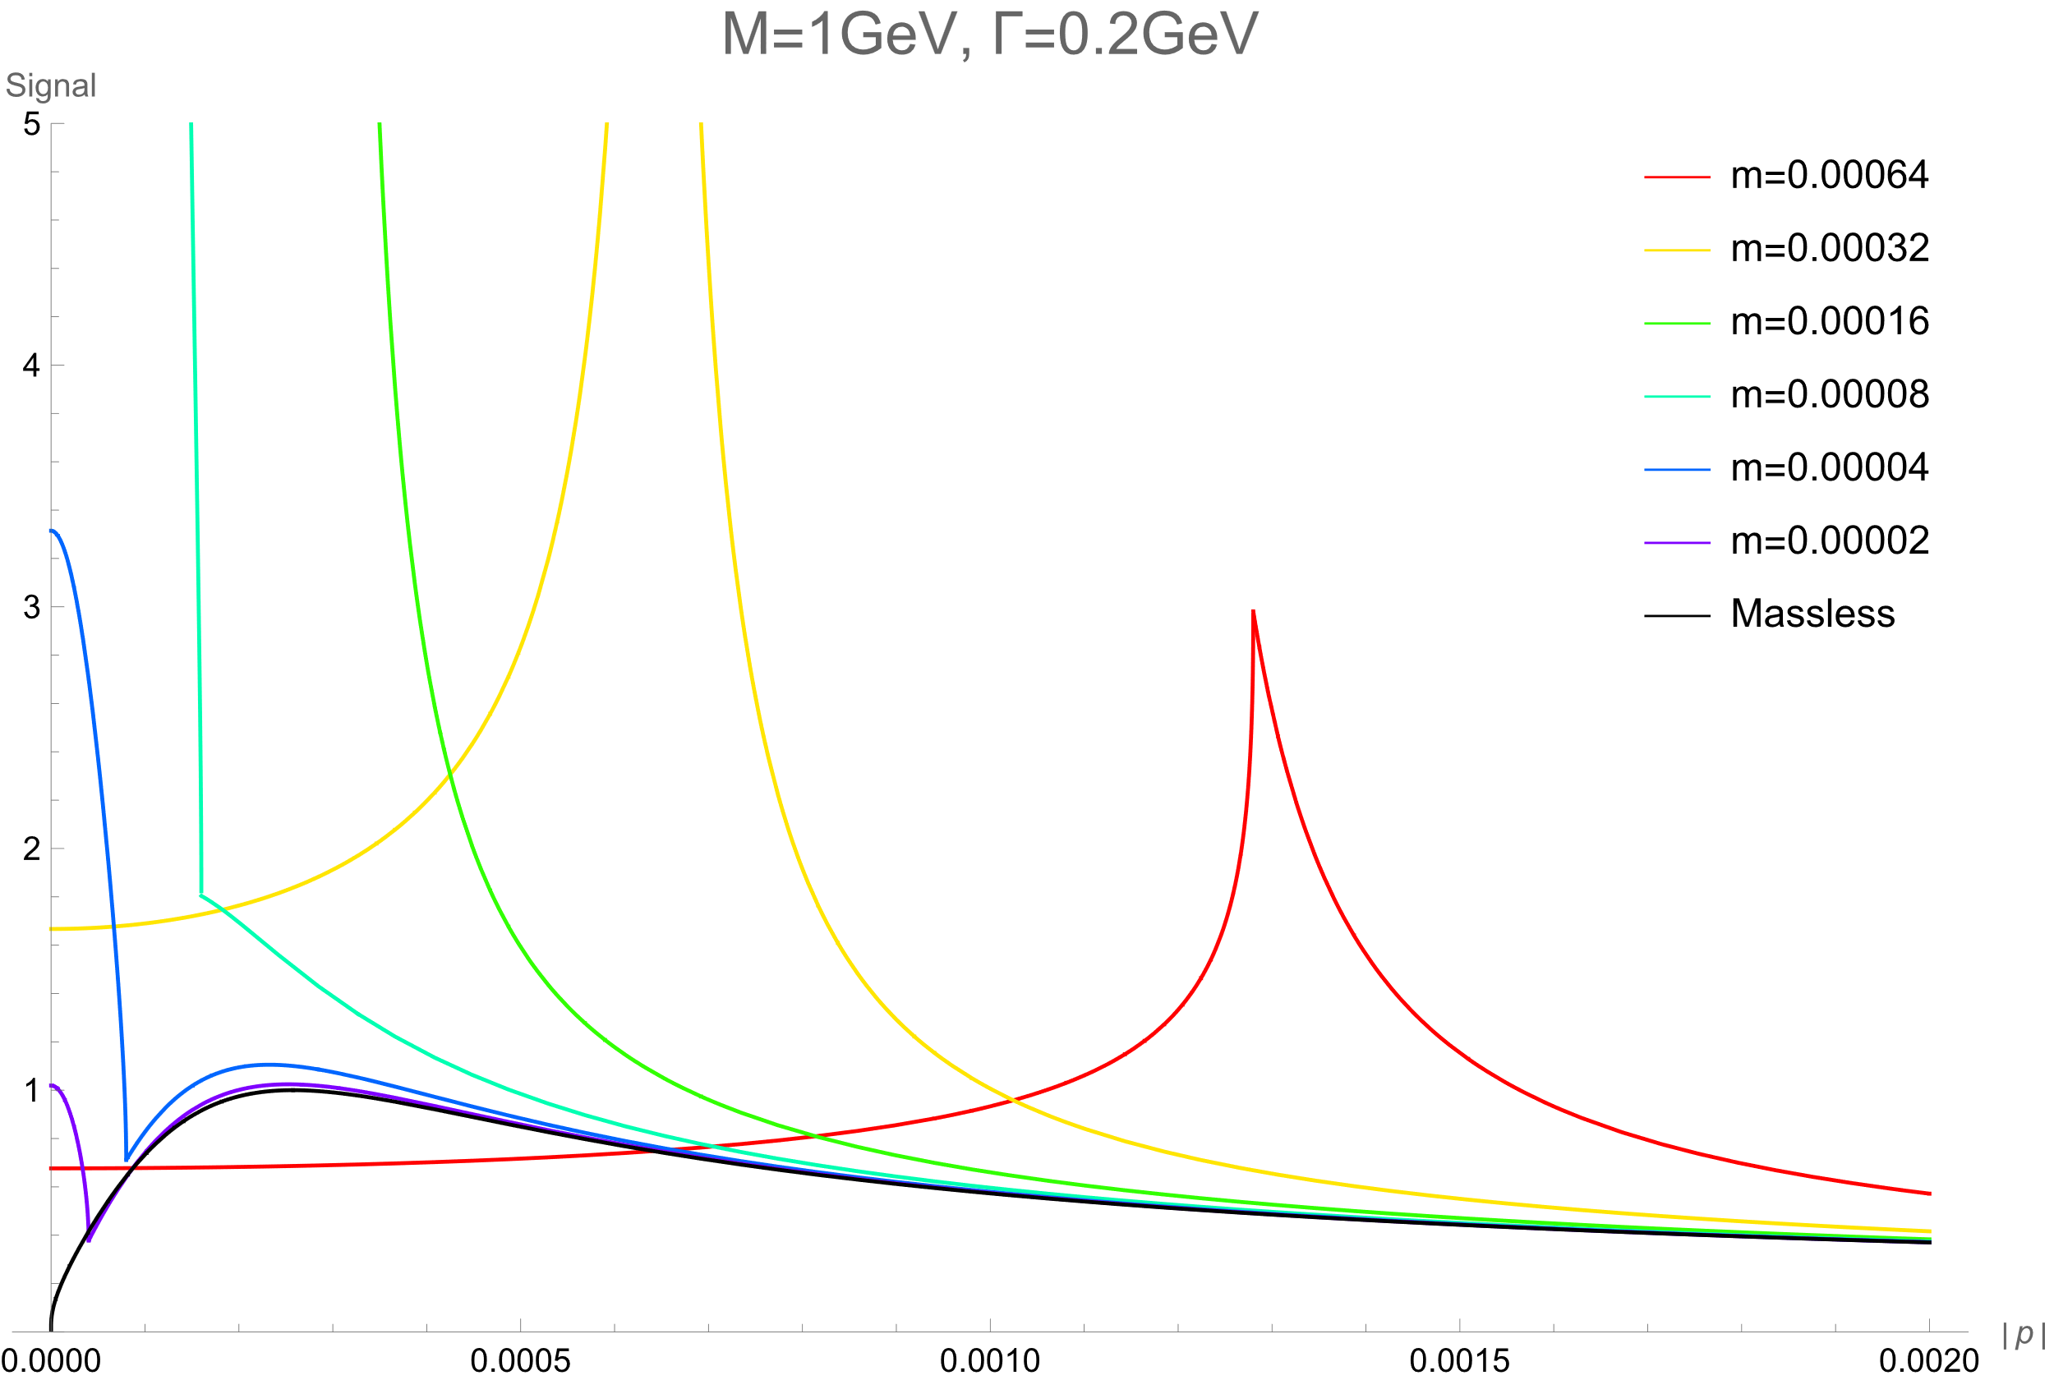
Signal Shape, near s=0
But the problem seems
worse for nonzero m
This is not IR divergence

